Slide 1
The Binomial, Poisson, and Normal Distributions

Slide 2
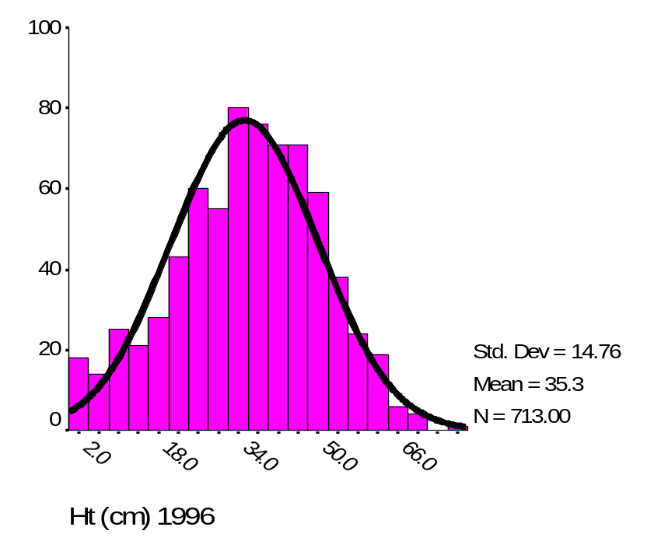

Probability distributions
We use probability distributions because they work –they fit lots of data in real world
Height (cm) of Hypericum cumulicola at Archbold Biological Station

Slide 3
Random variable
The mathematical rule (or function) that assigns a given numerical value to each possible outcome of an experiment in the sample space of interest.

Slide 4
Random variables
Discrete random variables
Continuous random variables

Slide 5
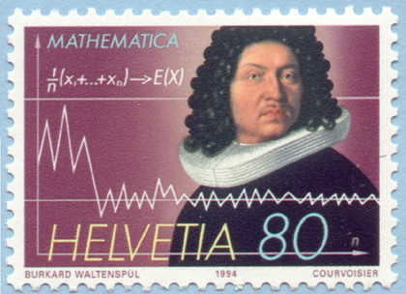
The Binomial Distribution
Bernoulli Random Variables
Imagine a simple trial with only two possible outcomes
  Success (S)
  Failure (F)
Examples
  Toss of a coin (heads or tails)
  Sex of a newborn (male or female)
  Survival of an organism in a region (live or die)
Jacob Bernoulli (1654-1705)

Slide 6
The Binomial Distribution
Overview
Suppose that the probability of success is p
What is the probability of failure?
  q = 1 – p
Examples
  Toss of a coin (S = head): p = 0.5 ⇒ q = 0.5
  Roll of a die (S = 1): p = 0.1667 ⇒ q = 0.8333
  Fertility of a chicken egg (S = fertile): p = 0.8 ⇒ q = 0.2

Slide 7
The Binomial Distribution
Overview
Imagine that a trial is repeated n times
Examples
  A coin is tossed 5 times
  A die is rolled 25 times
  50 chicken eggs are examined
Assume p remains constant from trial to trial and that the trials are statistically independent of each other

Slide 8
The Binomial Distribution
Overview
What is the probability of obtaining x successes in n trials?
Example
  What is the probability of obtaining 2 heads from a coin that was tossed 5 times?
  P(HHTTT) = (1/2)⁵ = 1/32

Slide 9
The Binomial Distribution
Overview
But there are more possibilities:
HHTTT HTHTT HTTHT HTTTH
THHTT THTHT THTTH
TTHHT TTHTH
TTTHH
P(2 heads) = 10 × 1/32 = 10/32

Slide 10
The Binomial Distribution
Overview
In general, if trials result in a series of success and failures,
FFSFFFFSFSFSSFFFFFSF…
Then the probability of x successes in that order is
P(x) = q ⋅ q ⋅ p ⋅ q ⋅ …
= p^{x} ⋅ q^{n – x}

Slide 11
The Binomial Distribution
Overview
However, if order is not important, then
where is the number of ways to obtain x successes
in n trials, and i! = i ⋅ (i – 1) ⋅ (i – 2) ⋅ … ⋅ 2 ⋅ 1
n!
P(x) =
p^{x} ⋅ q^{n – x}
x!(n – x)!
n!
x!(n – x)!

Slide 12
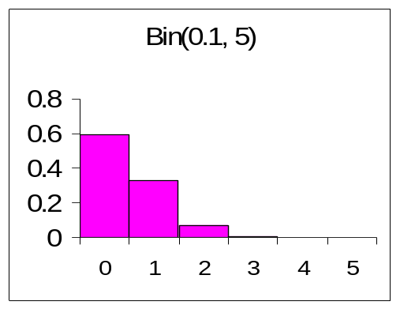
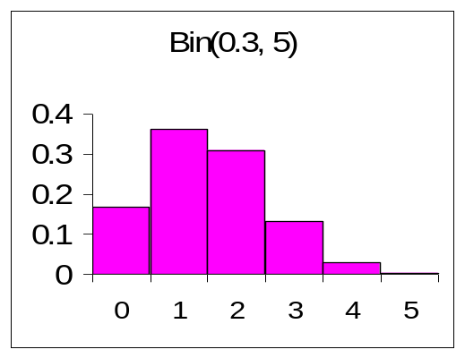
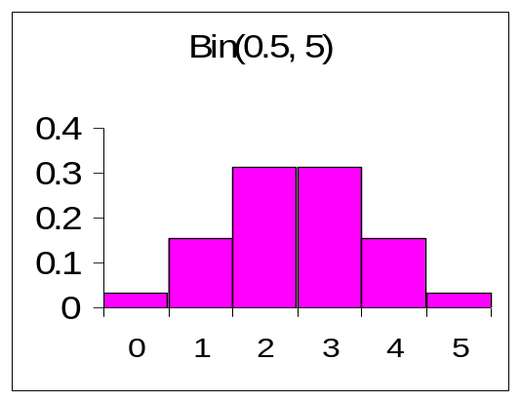
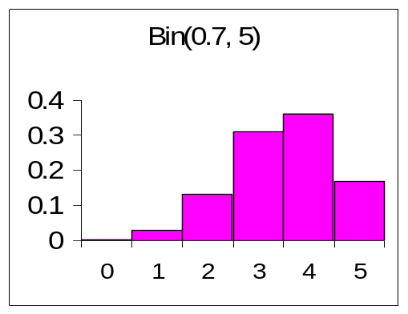
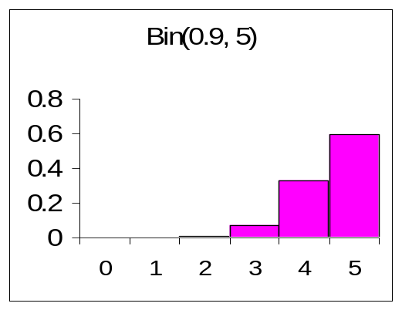
The Binomial Distribution
Overview

Slide 13
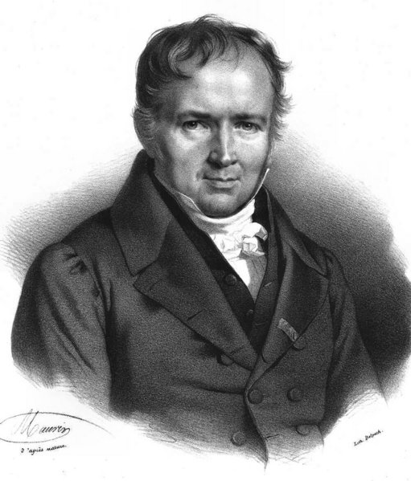
The Poisson Distribution
Overview
When there is a large number of trials, but a small probability of success, binomial calculation becomes impractical
  Example: Number of deaths from horse kicks in the Army in different years
The mean number of successes from n trials is µ = np
  Example: 64 deaths in 20 years from thousands of soldiers
Simeon D. Poisson (1781-1840)

Slide 14
The Poisson Distribution
Overview
If we substitute µ/n for p, and let n tend to infinity, the binomial distribution becomes the Poisson distribution:
e ^{-µ}µ^{x}
P(x) =
x!

Slide 15
The Poisson Distribution
Overview
Poisson distribution is applied where random events in space or time are expected to occur
Deviation from Poisson distribution may indicate some degree of non-randomness in the events under study
Investigation of cause may be of interest

Slide 16
The Poisson Distribution
Emission of α-particles
Rutherford, Geiger, and Bateman (1910) counted the number of α-particles emitted by a film of polonium in 2608 successive intervals of one-eighth of a minute
  What is n?
  What is p?
Do their data follow a Poisson distribution?

Slide 17
The Poisson Distribution
Emission of α-particles
No. α-particles | Observed
0 | 57
1 | 203
2 | 383
3 | 525
4 | 532
5 | 408
6 | 273
7 | 139
8 | 45
9 | 27
10 | 10
11 | 4
12 | 0
13 | 1
14 | 1
Over 14 | 0
Total | 2608
Calculation of µ:
µ = No. of particles per interval
= 10097/2608
= 3.87
Expected values:
e ^{-3.87}(3.87)^{x}
2680 × P(x) =
2608 ×
x!

Slide 18
The Poisson Distribution
Emission of α-particles
No. α-particles | Observed | Expected
0 | 57 | 54
1 | 203 | 210
2 | 383 | 407
3 | 525 | 525
4 | 532 | 508
5 | 408 | 394
6 | 273 | 254
7 | 139 | 140
8 | 45 | 68
9 | 27 | 29
10 | 10 | 11
11 | 4 | 4
12 | 0 | 1
13 | 1 | 1
14 | 1 | 1
Over 14 | 0 | 0
Total | 2608 | 2680

Slide 19

The Poisson Distribution
Emission of α-particles
Random events
Regular events
Clumped events

Slide 20
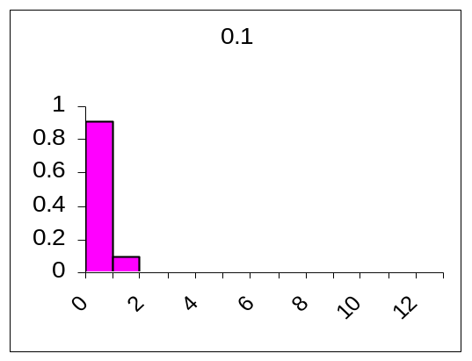
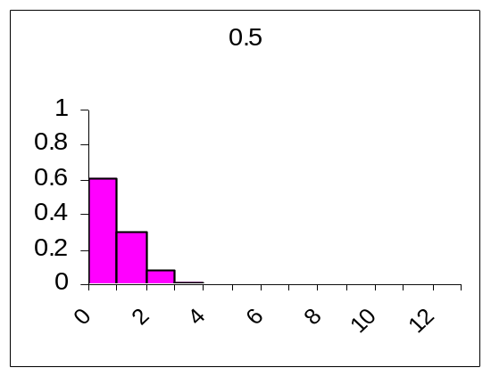
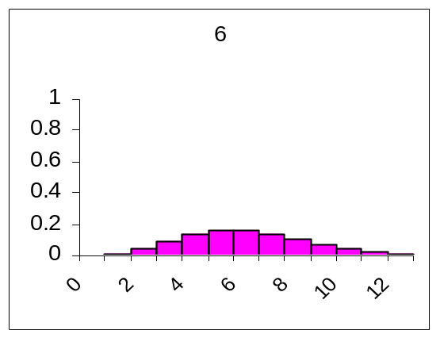
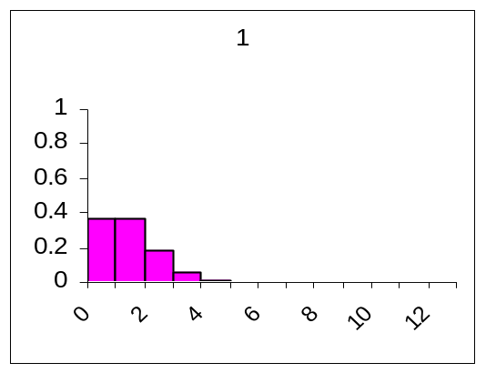
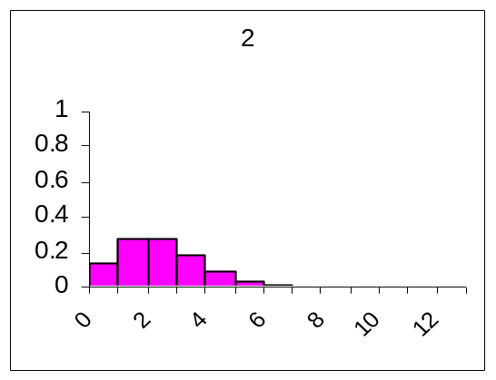
The Poisson Distribution

Slide 21
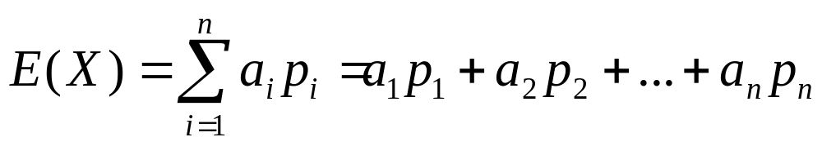
The Expected Value of a Discrete Random Variable

Slide 22
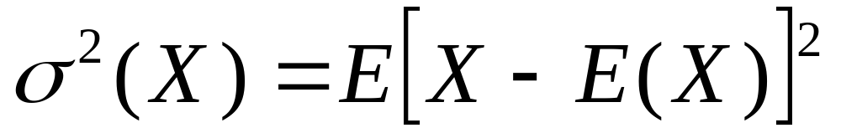
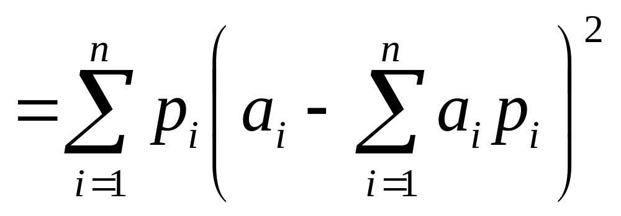
The Variance of a Discrete Random Variable

Slide 23

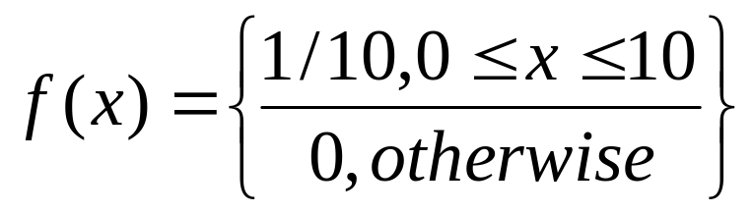
Uniform random variables
The closed unit interval, which contains all numbers between 0 and 1, including the two end points 0 and 1
Subinterval [5,6]
Subinterval [3,4]
The probability density function

Slide 24
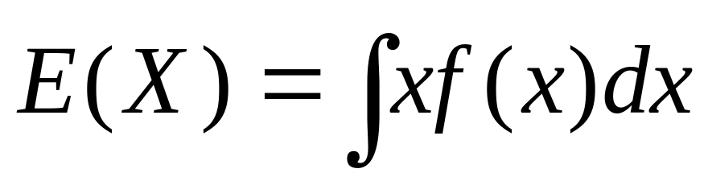
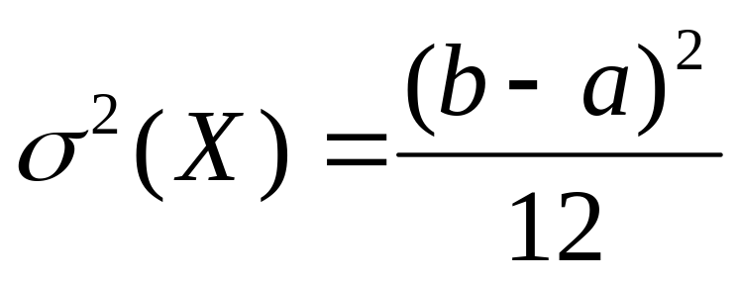
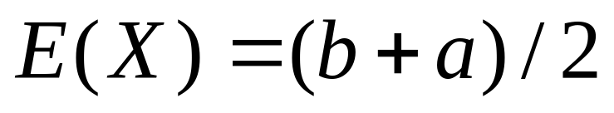
The Expected Value of a continuous Random Variable
For an uniform random variable x, where f(x) is defined on the interval [a,b], and where a<b,
and

Slide 25
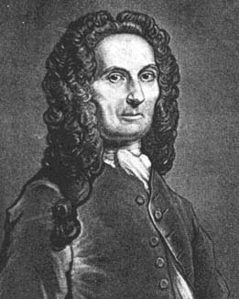

The Normal Distribution
Overview
Discovered in 1733 by de Moivre as an approximation to the binomial distribution when the number of trails is large
Derived in 1809 by Gauss
Importance lies in the Central Limit Theorem, which states that the sum of a large number of independent random variables (binomial, Poisson, etc.) will approximate a normal distribution
  Example: Human height is determined by a large number of factors, both genetic and environmental, which are additive in their effects. Thus, it follows a normal distribution.
Abraham de Moivre (1667-1754)
Karl F. Gauss (1777-1855)

Slide 26
The Normal Distribution
Overview
A continuous random variable is said to be normally distributed with mean μ and variance σ² if its probability density function is
f(x) is not the same as P(x)
  P(x) would be 0 for every x because the normal distribution is continuous
  However, P(x₁ < X ≤ x₂) = f(x)dx
1
f (x) =
−(x − μ)²/2σ²
e
σ√2π
x₂
∫
x₁

Slide 27
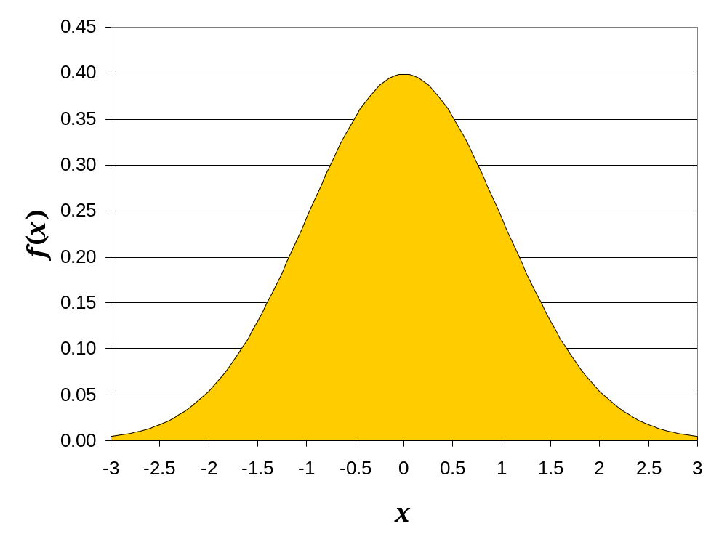
The Normal Distribution
Overview

Slide 28
The Normal Distribution
Overview

Slide 29
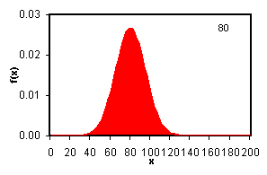
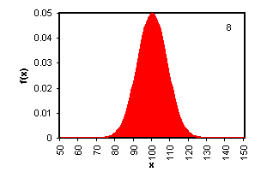
The Normal Distribution
Overview
Mean changes
Variance changes

Slide 30
The Normal Distribution
Length of Fish
A sample of rock cod in Monterey Bay suggests that the mean length of these fish is μ = 30 in. and σ² = 4 in.
Assume that the length of rock cod is a normal random variable
If we catch one of these fish in Monterey Bay,
  What is the probability that it will be at least 31 in. long?
  That it will be no more than 32 in. long?
  That its length will be between 26 and 29 inches?

Slide 31
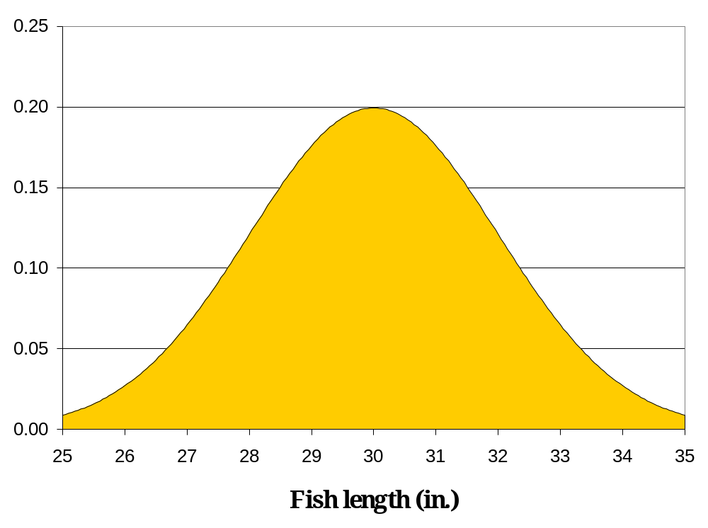
The Normal Distribution
Length of Fish
What is the probability that it will be at least 31 in. long?

Slide 32
The Normal Distribution
Length of Fish
That it will be no more than 32 in. long?

Slide 33
The Normal Distribution
Length of Fish
That its length will be between 26 and 29 inches?

Slide 34
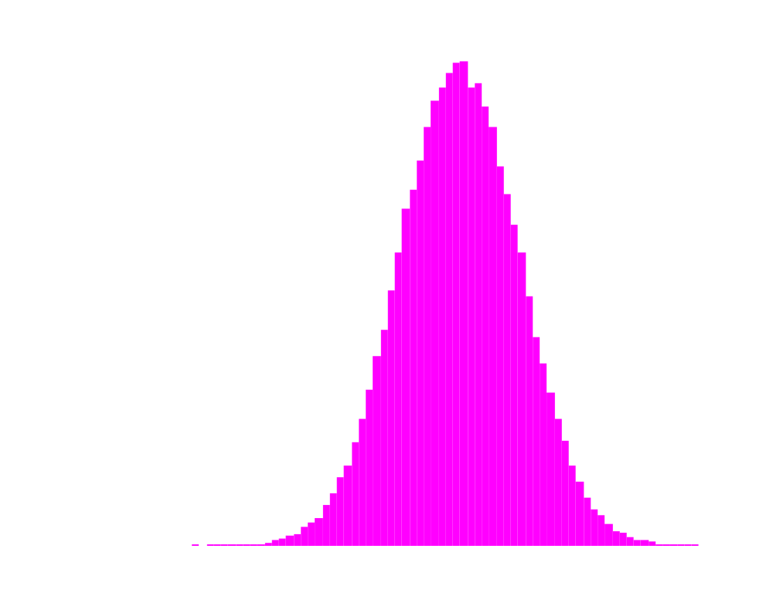
Standard Normal Distribution
μ=0 and σ²=1

Slide 35
Useful properties of the normal distribution
The normal distribution has useful properties:
Can be added E(X+Y)= E(X)+E(Y) and σ2(X+Y)= σ2(X)+ σ2(Y)
Can be transformed with shift and change of scale operations

Slide 36
Consider two random variables X and Y
Let X~N(μ,σ) and let Y=aX+b where a and b area constants
Change of scale is the operation of multiplying X by a constant “a” because one unit of X becomes “a” units of Y.
Shift is the operation of adding a constant “b” to X because we simply move our random variable X “b” units along the x-axis.
If X is a normal random variable, then the new random variable Y created by this operations on X is also a random normal variable

Slide 37
For X~N(μ,σ) and Y=aX+b
E(Y) =aμ+b
σ²(Y)=a² σ²
A special case of a change of scale and shift operation in which a = 1/σ and b =-1(μ/σ)
Y=(1/σ)X-μ/σ
Y=(X-μ)/σ gives
E(Y)=0 and σ²(Y) =1

Slide 38
The Central Limit Theorem
That Standardizing any random variable that itself is a sum or average of a set of independent random variables results in a new random variable that is nearly the same as a standard normal one.
The only caveats are that the sample size must be large enough and that the observations themselves must be independent and all drawn from a distribution with common expectation and variance.

Slide 39

Exercise
Location of the measurement

